Slide 1
Structured ALE Solver

Slide 2
Overview
Solve for multiple materials in a ALE mesh domain
Structured ALE mesh automatically generated
Much shorter calculation time
Support multiple S-ALE domains
Large problems with less memory
SMP, MPP, MPP-Hybrid supported
2

Slide 3
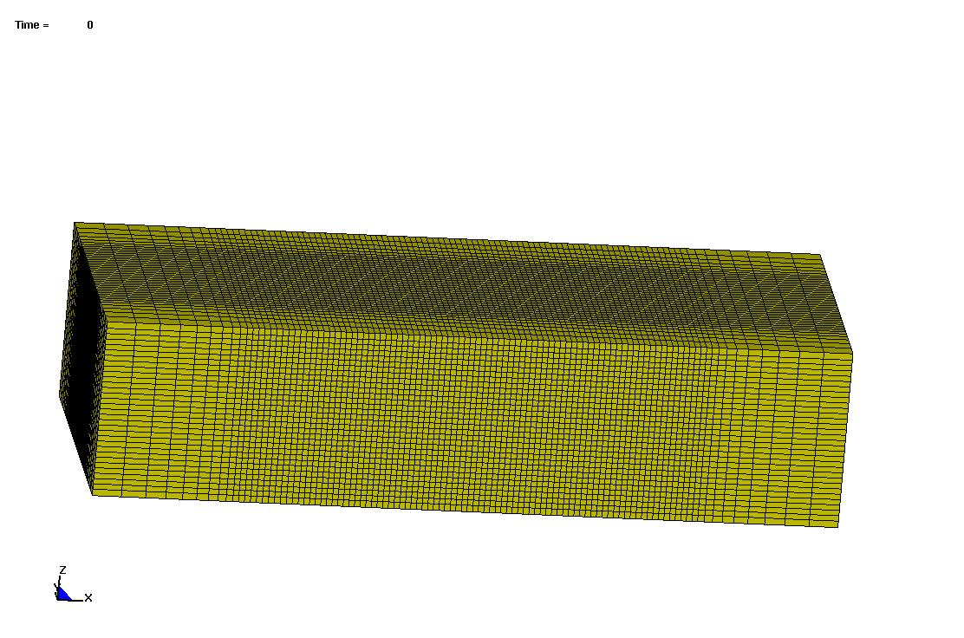
Automated Mesh Generation
User specifies mesh spacing information along three directions
One node for mesh origin and another three for local coordinate system; Later during the run used to prescribe mesh translational motion and rotation
3

Slide 4
Keywords
*ALE_STRUCTURED_MESH
*ALE_STRUCTURED_MESH_CONTROL_POINTS
*ALE_STRUCTURED_MESH
MSHID | PID | NBID | EBID
CPIDX | CPIDY | CPIDZ | NID0 | LCSID
*ALE_STRUCTURED_MESH_CONTROL_POINTS
CPID |  |  | SFO |  | OFF0
NID1 |  | X1
NID2 |  | X2
4

Slide 5
Time Saving
Much faster FSI (Fluid structure interaction) searching for structured ALE mesh
Redesigned volume flux calculation enabled a faster advection scheme supports SMP.
Time saving in a Bridgestone tire rolling in mud model
 | ALE | S-ALE | Reduction
Total Time | 30941s | 20120s | 34.97%
FSI | 15449s | 5726s | 63%
Advection | 7595s | 6642s | 12.55%
134400 ALE solid elements; Simulation time 2000ms.
Single precision MPP 48 cpus without special decomposition
5

Slide 6
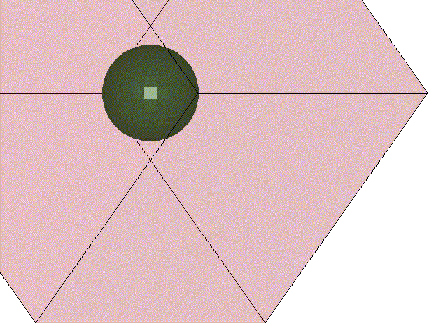
SMP & MPP Hybrid Supported
Airbag inflated by ideal gas and then kept still.; 9261 ALE solids elements with 294 shells.

Slide 7
Donor Cell (1st order)
SMP Result: Single precision -1, -2, -4, -8 cpu;
clock time spent in S-ALE solver listed in the table (Haswell1)
NCPU | -1 | -2 | -4 | -8
Time (s) | 298 | 168 | 103 | 70
Speedup |  | 1.77 | 2.87 | 4.25
MPP Hybrid Result: Single precision 24x-1, 12x-2, 8x-3, 6x-4
clock time spent in S-ALE solver listed in the table (Barstow); 1x-1 case 530s
NCPU | 24x-1 | 12x-2 | 8x-3 | 6x-4
Time (s) | 55 | 57 | 60 | 60
Speedup | 9.72 | 9.32 | 8.80 | 8.80
Both SMP and MPP Hybrid provide consistent answers with multiple threads (NCPU=-N);

Slide 8
Van Leer (2nd order)
SMP Result: Single precision -1, -2, -4, -8 cpu;
clock time spent in S-ALE solver listed in the table (Haswell1)
NCPU | -1 | -2 | -4 | -8
Time (s) | 531 | 292 | 179 | 111
Speedup |  | 1.82 | 2.97 | 4.78
MPP Hybrid Result: Single precision 24x-1, 12x-2, 8x-3, 6x-4
clock time spent in S-ALE solver listed in the table (Barstow); 1x-1 case 1000s
NCPU | 24x-1 | 12x-2 | 8x-3 | 6x-4
Time (s) | 90 | 94 | 99 | 98
Speedup | 11.05 | 10.68 | 10.13 | 10.16
Both SMP and MPP Hybrid provide consistent answers with multiple threads (NCPU=-N);

Slide 9
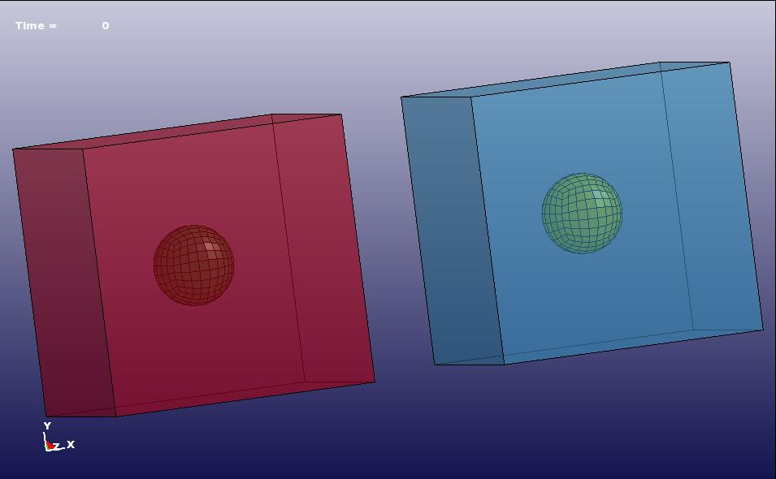
Multiple Mesh Domains
Multiple meshes can be generated.
Each mesh domain is solved independently; unaware of others’ existence.
Different meshes can occupy SAME spatial domain.

Slide 10
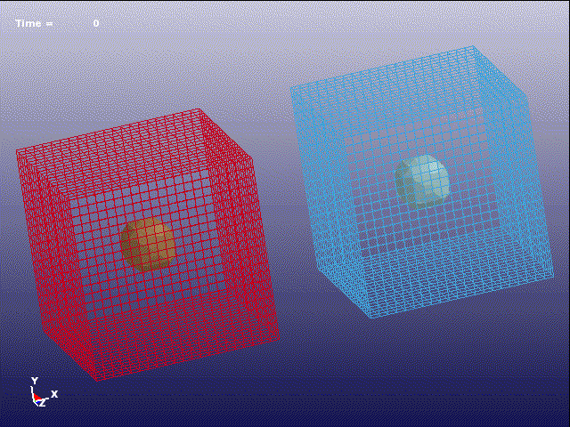
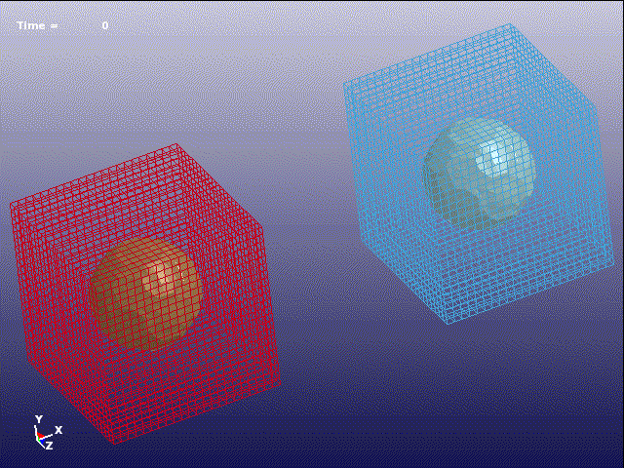
Multiple Mesh Domains
Two pressurized airbags, each inside an independent S-ALE mesh.
Contact between bags DISABLED
Contact between bags ENABLED
10

Slide 11
Supporting Large Problems
S-ALE uses much less memory in MPP decomposition phase. For the underwater explosion case, 31 million elements run uses less than 2G words. The largest problem tested so far is with 140 million elements.
Comparison for the 8x8x8 refinement case between ALE and SMMALE
Refinement | Number of Elements | Clock Time | Number of Cycles
8x8x8 | 2,359,296 | 199s | 745
16x16x16 | 18,874,168 | 2891s | 1514
19x19x19 | 31,606,272 | 5618s | 1806
Solver | MAX Memory (words) | Clock Time (s)
ALE | 414M | 312
MMALE | 158M | 199
48 CPU MPP Single Precision

Slide 12
Thank You

